Slide 1
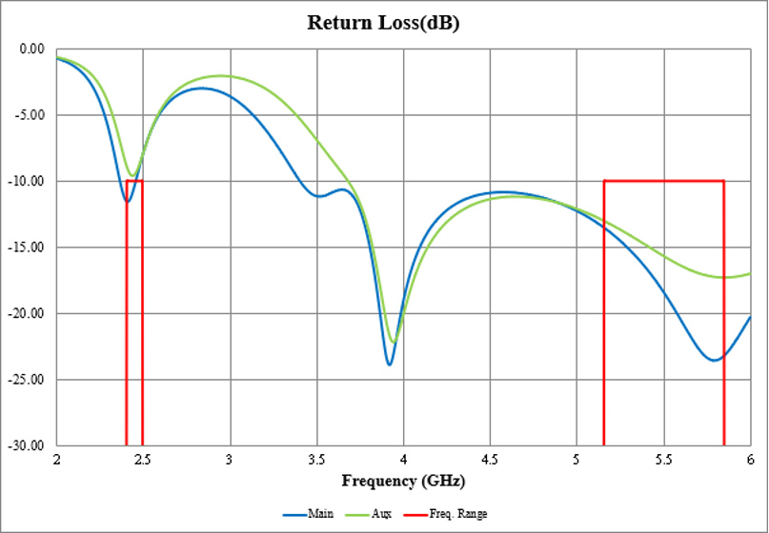
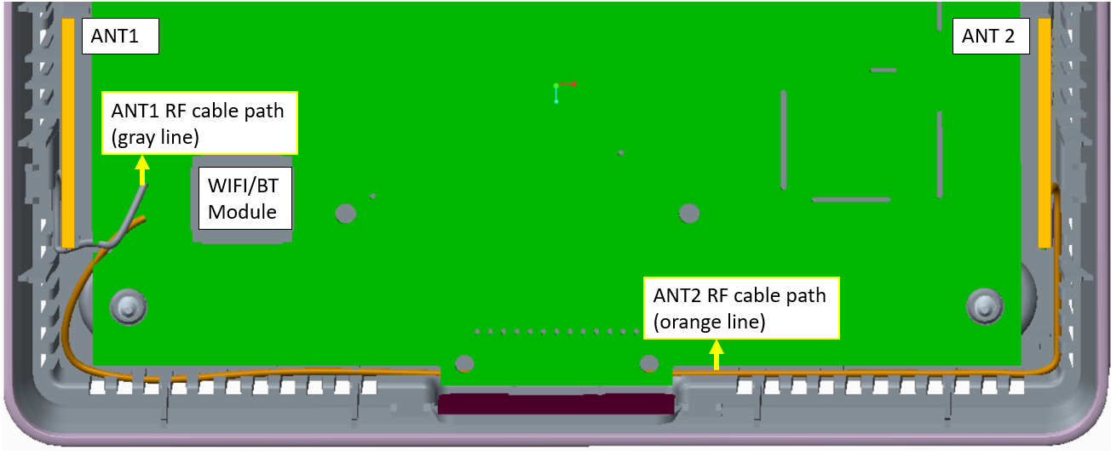
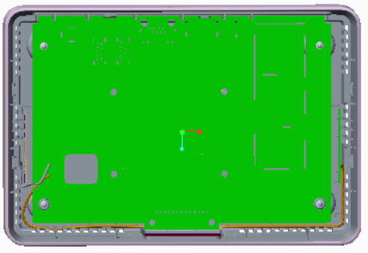
Design prepare
Simulation (HFSS)
Return Loss
Mechanical drawing
[ALT 0512] According to SKB’S RFP, the Antenna type is not cable but chip antenna. So could you update your model with chip antenna type?
* RF cable path refer to above plot with gray and orange line
Efficiency
ANT1 | 5.15G | 5.35G | 5.55G | 5.85G
Efficiency(%) | 67 | 69 | 70 | 72
OTT BOX
ANT2 | 5.15G | 5.35G | 5.55G | 5.85G
Efficiency(%) | 68 | 67 | 67 | 68
* Above is reference data, need to use actual PCB to test

Slide 2
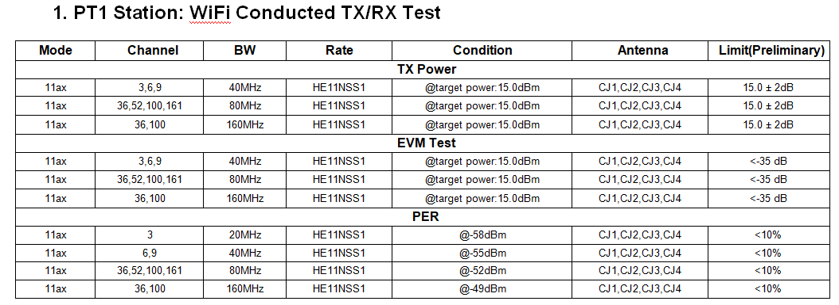
Wi-Fi Manufacturing Process (2/4)
Calibration
Radiation test
Conducted test
OBA test
WIFI Conducted test
  Test diagram
  Test spec
[ALT 0512] 11ax is not supported at SKB’s dongle model. Please change the another mode.
802.11a/n/ac . Frequency list, Test spec, Calibration & verification or only have verification
  Transmit power measurement
  Transmitter spectral mask test
  Transmit Center Frequency Error
  Transmit Power
  Transmit modulation accuracy (EVM)
  Receiver minimum input level sensitivity
  Receiver maximum input level

